Slide 1
Workshop: iOS Testing
HungNV
ChauNN

Slide 2
Overview
Session 1: Introduced Kaizen iOS template.
Session 2: iOS automation test – XCUITest.
Session 3: Unit test – Quick & Nimble.

Slide 3
Session 1: Kaizen iOS template
Github link: https://github.com/vitalifyjp/Kaizen_IOS_Template
Coding role:
Document: https://vfa-chaunn.gitbook.io/kaizen-ios-template-gui/

Slide 4
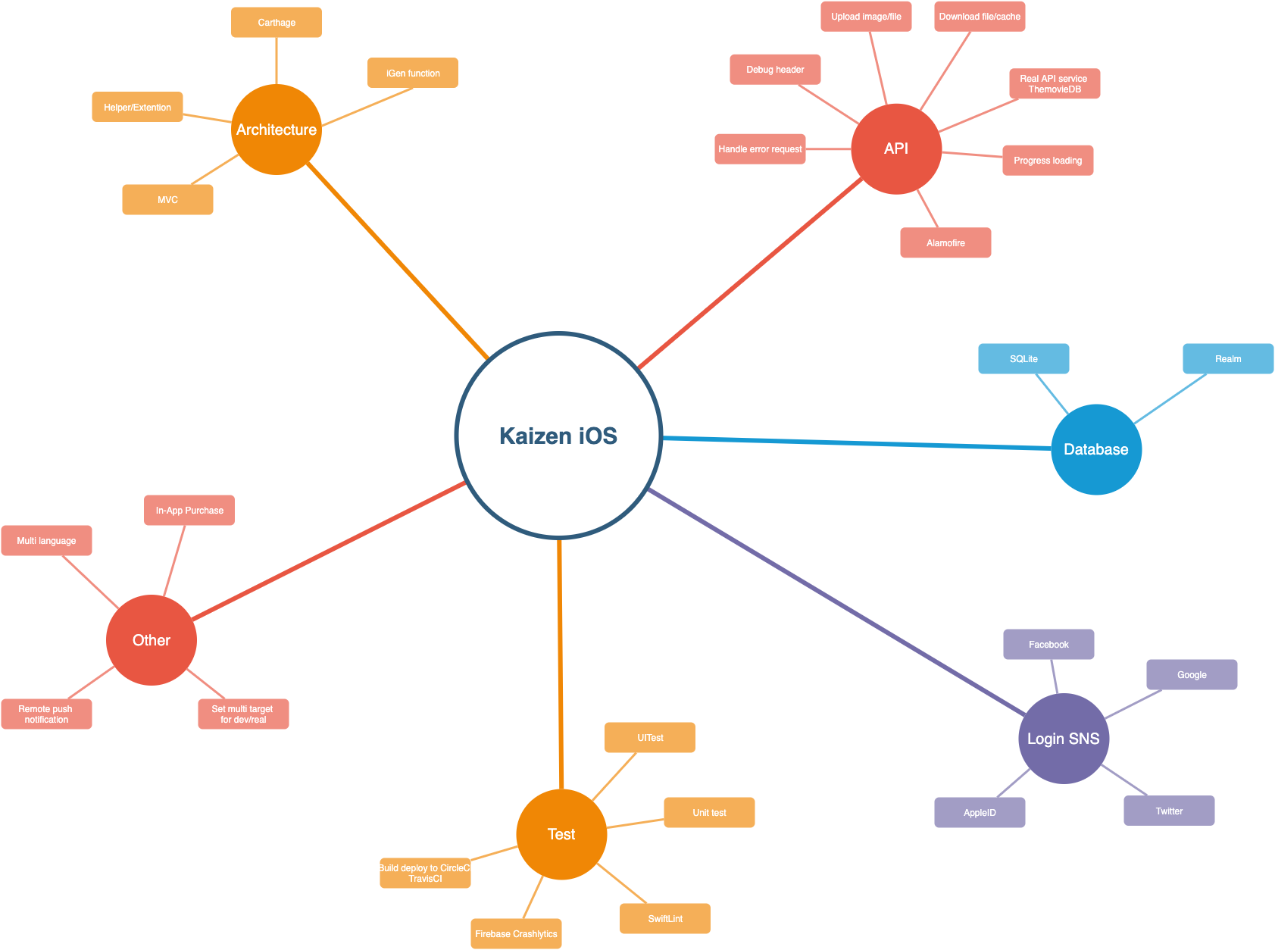
Functions

Slide 5
Session 2: iOS UI Testing in Xcode (iOS Automation)

Slide 6
Overview
Introduction XCUITest.
Record and Playback.
Demo.

Slide 7
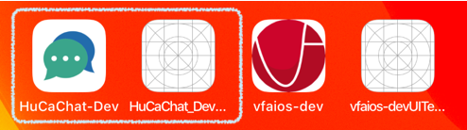
XCUITest
Introduced in Xcode 7 in 2015
xUnit Test cases (XCTestCase)
UITest targets can’t see production codes
Builds and tests are all executed using XCode (ObjC/Swift)
Record functionality

Slide 8
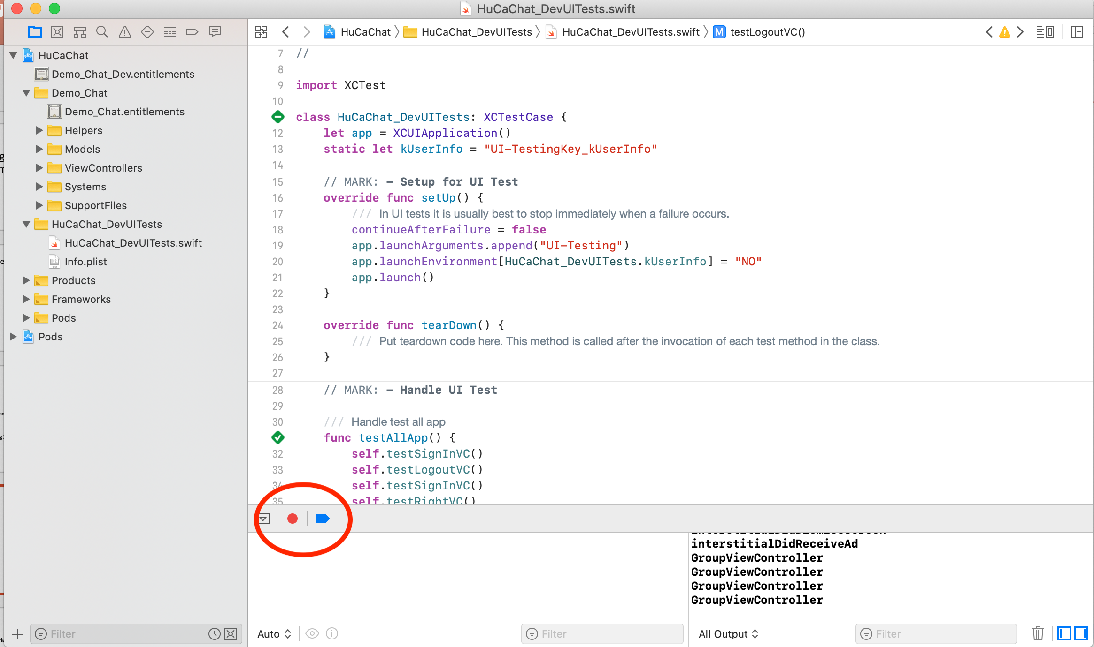
XCUITest – Recording and playback

Slide 9
UI Testing API
XCUIApplication
XCUIElement
XCUIElementQuery

Slide 10
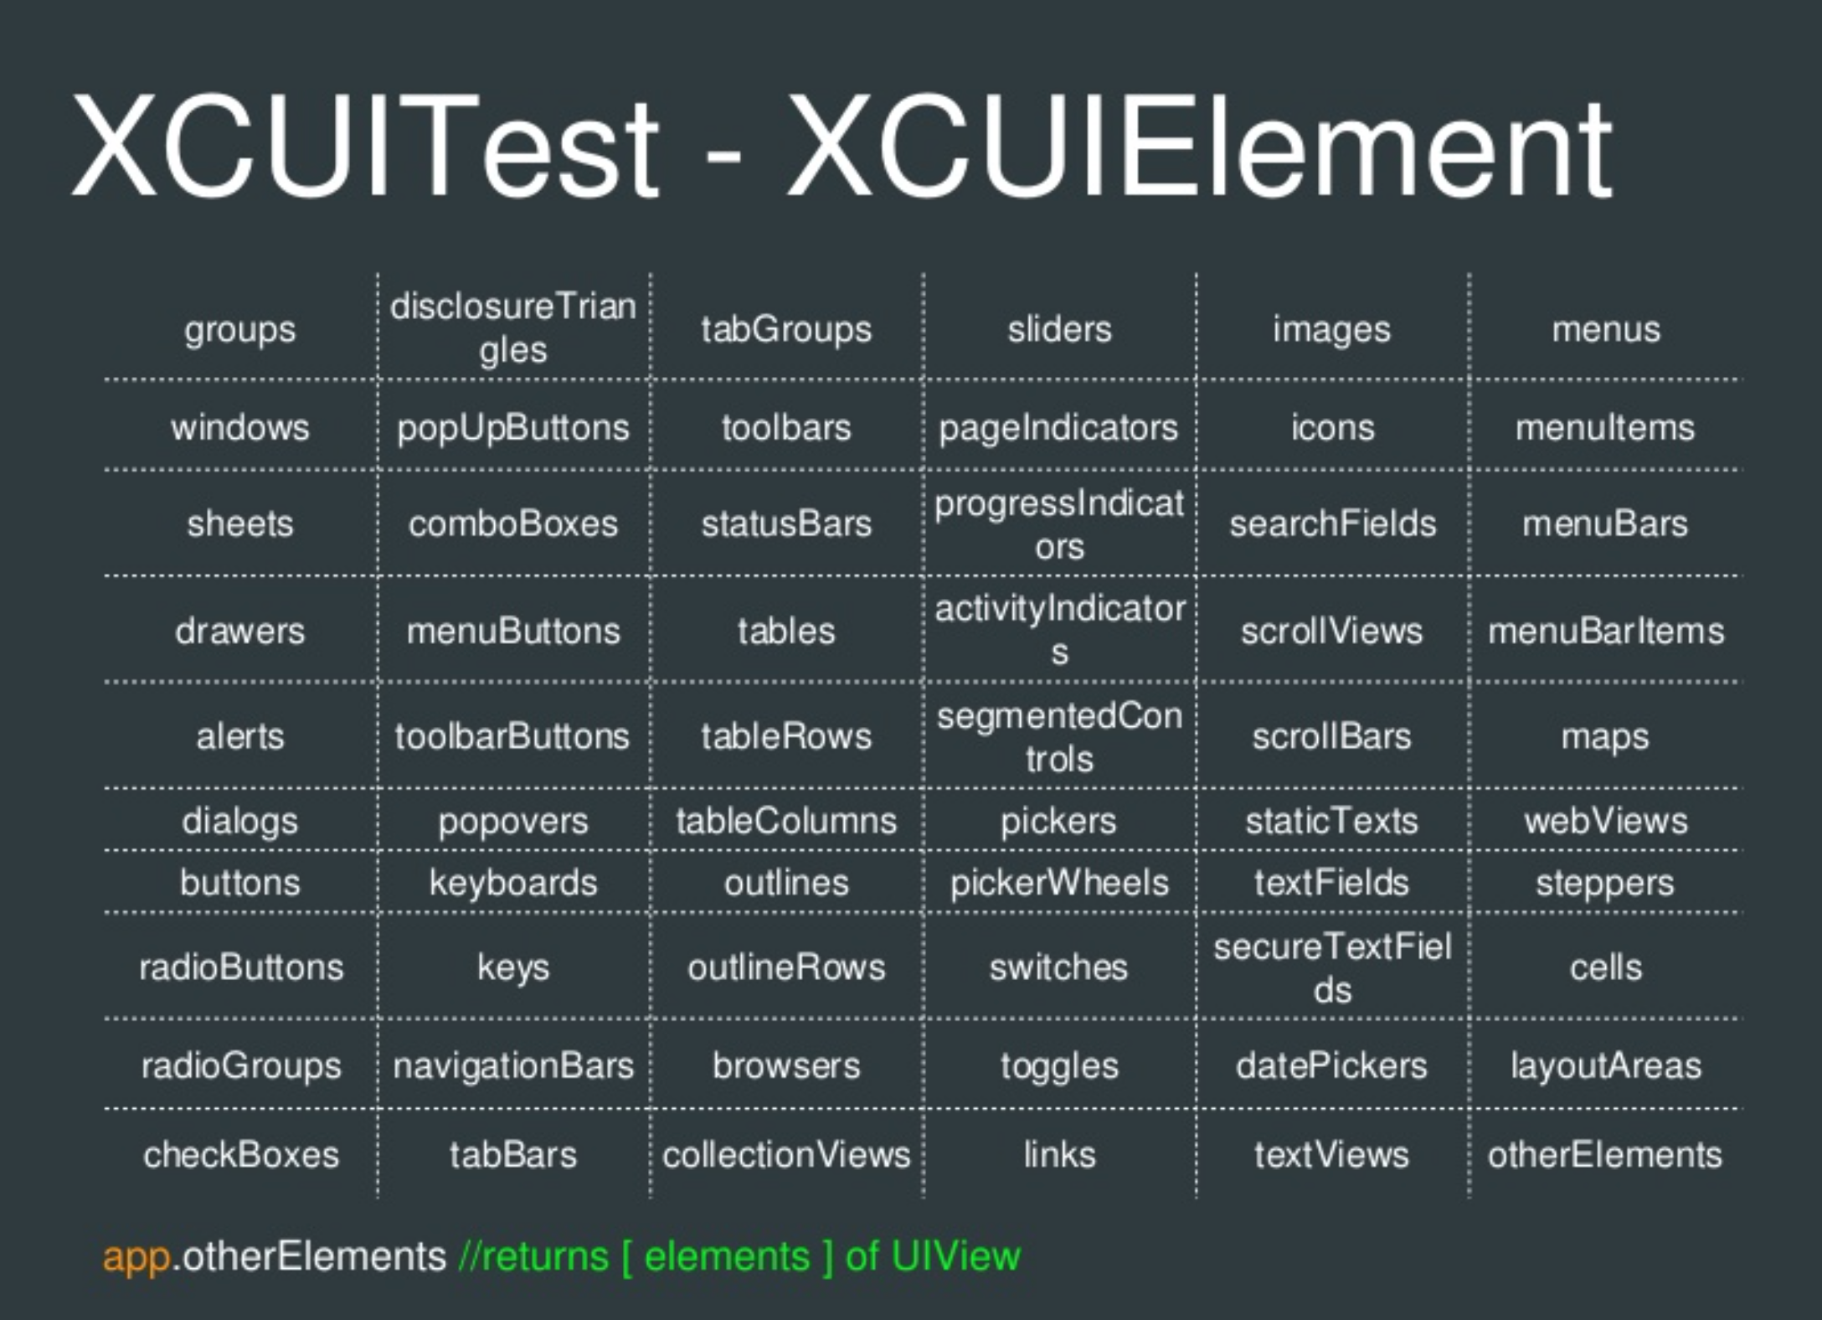

Slide 11
Example
Testing the Add button
// application:
let app = XCUIApplication() app.launch()
// element and query:
let addButton = app.buttons[“Add”] addButton.tap()
// assertion: XCTAssertEqual(app.tables.cells.count, 1)

Slide 12

Example
Testing the Add button
// application:
let app = XCUIApplication()
app.launch()
// element and query:
let addButton = app.buttons[“Add”] addButton.tap()
// assertion: XCTAssertEqual(app.tables.cells.count, 1)

Slide 13
Example
Testing the Add button
// application:
let app = XCUIApplication()
app.launch()
// element and query:
let addButton = app.buttons[“Add”] addButton.tap()
// assertion: XCTAssertEqual(app.tables.cells.count, 1)

Slide 14
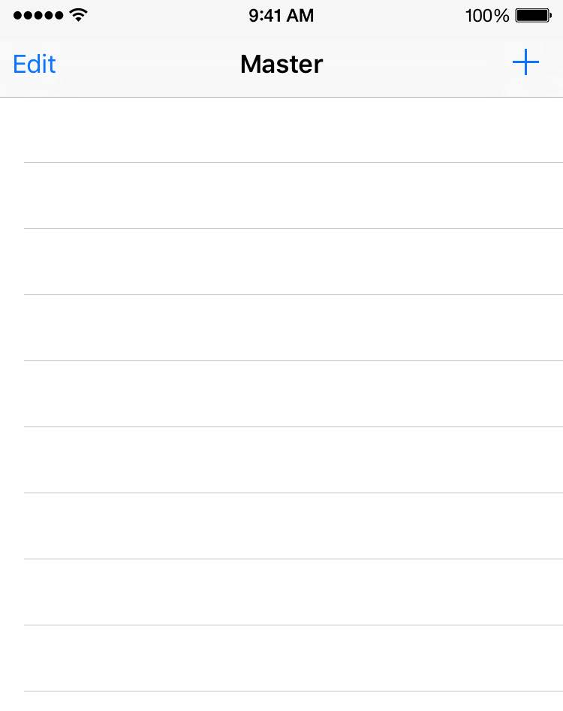
Example
Testing the Add button
// application:
let app = XCUIApplication()
app.launch()
// element and query:
let addButton = app.buttons[“Add”] addButton.tap()
// assertion: XCTAssertEqual(app.tables.cells.count, 1)

Slide 15
Example
Testing the Add button
// application:
let app = XCUIApplication() app.launch()
// element and query:
let addButton = app.buttons[“Add”]
addButton.tap()
// assertion: XCTAssertEqual(app.tables.cells.count, 1)

Slide 16


Example
Testing the Add button
// application:
let app = XCUIApplication() app.launch()
// element and query:
let addButton = app.buttons[“Add”]
addButton.tap()
// assertion: XCTAssertEqual(app.tables.cells.count, 1)

Slide 17
Example
Testing the Add button
// application:
let app = XCUIApplication() app.launch()
// element and query:
let addButton = app.buttons[“Add”]
addButton.tap()
// assertion: XCTAssertEqual(app.tables.cells.count, 1)

Slide 18

Example
Testing the Add button
// application:
let app = XCUIApplication() app.launch()
// element and query:
let addButton = app.buttons[“Add”]
addButton.tap()
// assertion: XCTAssertEqual(app.tables.cells.count, 1)

Slide 19
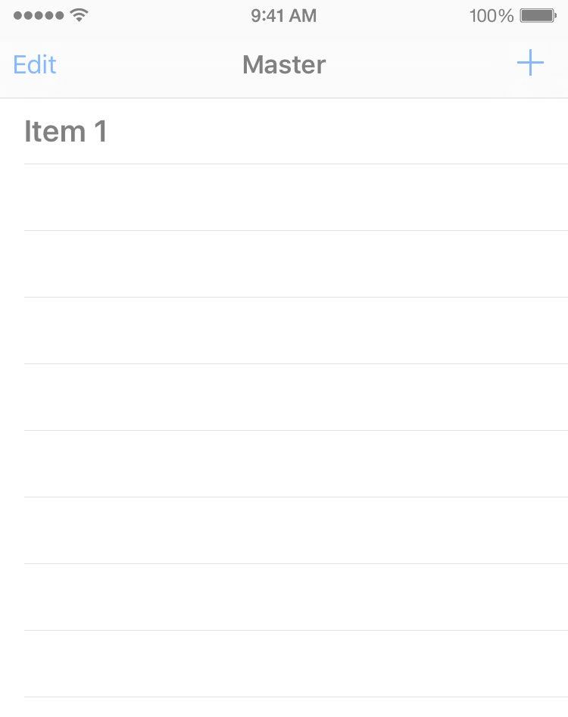
Example
Testing the Add button
// application:
let app = XCUIApplication() app.launch()
// element and query:
let addButton = app.buttons[“Add”] addButton.tap()
// assertion:
XCTAssertEqual(app.tables.cells.count, 1)

Slide 20
Demo
Demo 1: UI Recording – Record and Playback
YouTube link
Demo 2: How does iOS automation work?
Github: https://github.com/vfaHungnv/simpleapp/tree/develop

Slide 21
Session 3: Unit test – Testing with Quick & Nimble.

Slide 22
Overview
Introduced XCTest vs Quick and Nimble.
How to use Quick and Nimble.
Script for test case.
Demo.

Slide 23
Comparison between XCTest vs Quick and Nimble
XCTest is a testing framework provided by Apple. You need to be aware of setup() and tearDown() functions. XCTAssertions are also pretty inconvenient to use. Very long function names.
Quick is a testing framework which provides a convenient method to compose a unit test. It uses the single function spec() to define the whole test. The sections are describe, context and it. I will explain the purpose and benefits of such a setup later in this article.
Nimble is a matching framework which provides plenty of options how to fulfill your test expectations.

Slide 24
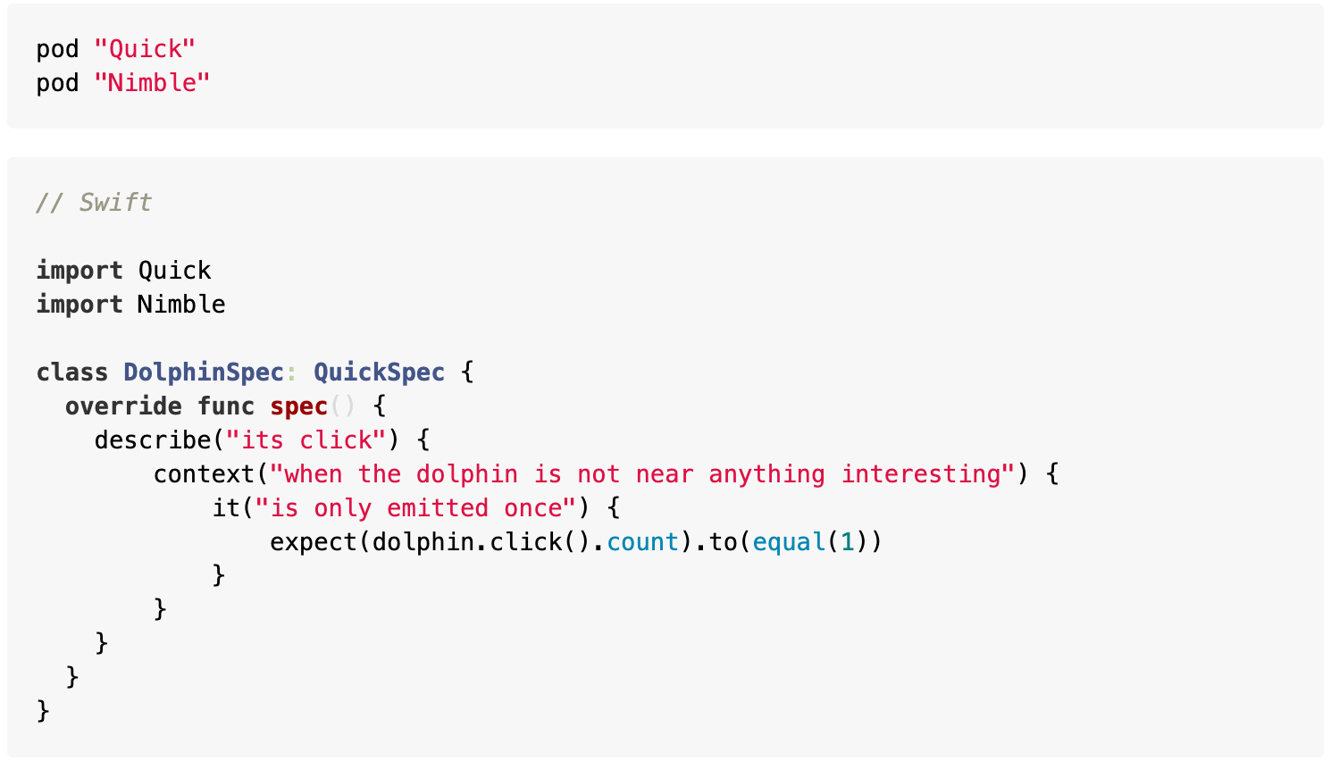
How to use Quick and Nimble
You can either use Cathage or Cocoa Pod.

Slide 25
Introduction Quick
describe: An arbitrary string describing the example group.
context: Defines an example group. Equivalent to `describe`.
it: Defines an example. Examples use assertions to demonstrate how code should behave. These are like "tests" in XCTest.

Slide 26
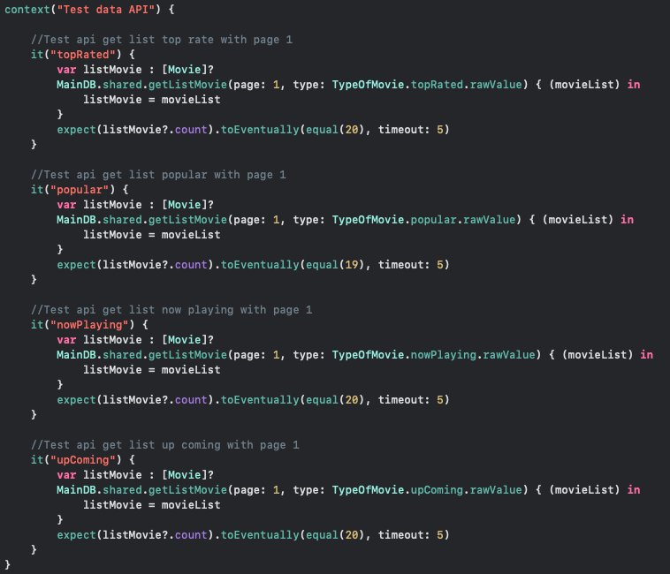
Script for test case.
1. Test number of element movie
into from API .

Slide 27
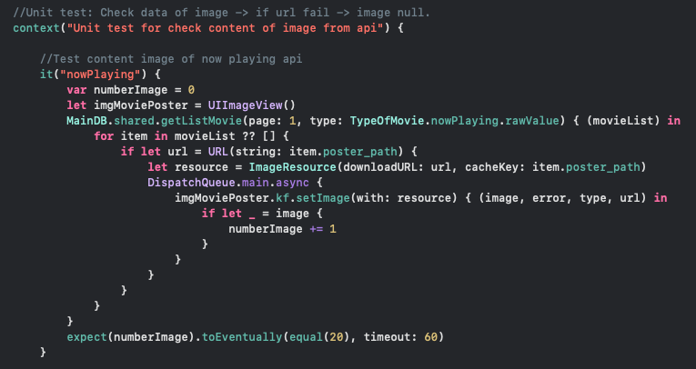
2. Test correct url thumbnail for each movie from API.

Slide 28
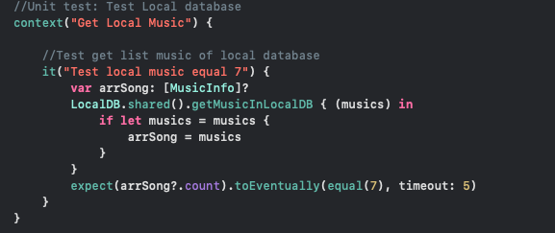
3. Test number of music into local DB.

Slide 29
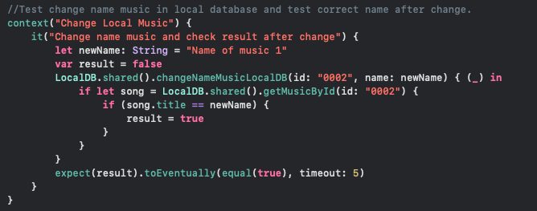
4. Test change data of music into local DB.

Slide 30
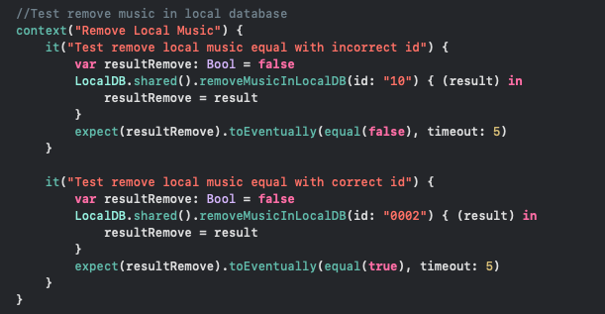
5. Test delete music into local DB.

Slide 31
Reference
Quick and Nimble: https://medium.com/inloopx/tdd-using-quick-nimble-244b14b09e3d
UITest call API: https://www.raywenderlich.com/960290-ios-unit-testing-and-ui-testing-tutorial
UITest: https://useyourloaf.com/blog/ui-testing-quick-guide/
WWDC: https://developer.apple.com/videos/developer-tools/testing
UnitTest – Quick & Nimble: https://medium.com/inloopx/tdd-using-quick-nimble-244b14b09e3d

Slide 32
Q.A – Thank you!!!

